Slide 1
CS 540 Network Architecture
Lecture 19 : Ad-hoc Networks, VANET
Prof. Younghee Lee

Slide 2
Taxonomy
Wireless
Networking
Single
Hop
Multi-hop
Infrastructure-based
(hub&spoke)
Infrastructure-less
(ad-hoc)
Infrastructure-based
(Hybrid)
Infrastructure-less
(MANET)
802.11
802.16
802.11
Bluetooth
Cellular
Networks
Wireless Sensor
Networks(?)
Wireless Mesh
Networks
Car-to-car
Networks
(VANETs)

Slide 3
Routing Protocols
Proactive protocols
Establish routes in advance
Traditional link-state and distance-vector routing protocols are proactive
Table driven Routing protocol
Destination Sequenced Distance Vector Routing(DSDV)
Clusterhead Gateway Switch Routing(CGSR)
Reactive protocols
Establish routes only if needed
Less routing overhead, but higher latency in establishing the path
Source-initiated on-demand
AODV, DSR, LMR, TORA, ABR, SSR
Hybrid protocols
Proactive within a restricted geographic area, reactive if a packet must traverse several of these areas
ZRP, LANMAR

Slide 4
Trade-Off
Latency of route discovery
Proactive protocols: Little or no delay for route determination
since routes are maintained at all times
Reactive protocols: Significant delay in route determination
Employ flooding (global search)
Control traffic may be bursty
Overhead of route discovery/maintenance
Proactive protocols: Consume bandwidth to keep routes up-to-date
Maintain routes which may never be used
Reactive protocols: Lower overhead since routes are determined on demand
Which approach achieves a better trade-off depends on the traffic and mobility patterns
Low traffic with high mobility : Reactive : winner?
High traffic with low mobility : Proactive

Slide 5
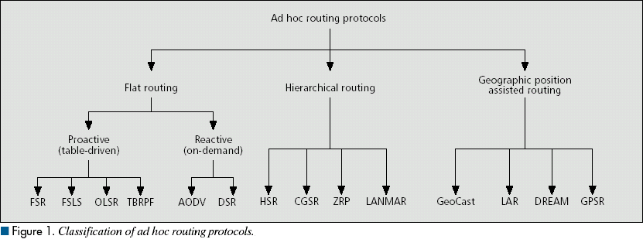
Ad hoc routing protocols
Ad hoc routing protocols
Table-driven
Source-initiated
On-demand
DSDV
WRP
AODV
DSR
LMR
ABR
CGSR
TORA
SSR

Slide 6
Proactive Protocols
Distance vector
Finding shortest path to destination using the route information from neighbor nodes
Bellman-ford
Count to infinity problem
Link state
Each node advertise link information using flooding
Each node calculate shortest path

Slide 7
Destination-Sequenced Distance-Vector (DSDV) [Perkins94Sigcomm]
Each node maintains a routing table which stores
next hop towards each destination
a cost metric for the path to each destination
a destination sequence number that is created by the destination itself
Sequence numbers used to avoid formation of loops : why?
Each node periodically forwards the routing table to its neighbors
Each node increments and appends its sequence number when sending its local routing table
This sequence number will be attached to route entries created for this node
Each route is tagged with a sequence number; routes with greater sequence numbers are preferred: newer one
When a node decides that a route is broken, it increments the sequence number of the route and advertises it with infinite metric
Node mobility : routing data update period

Slide 8
Destination-Sequenced Distance-Vector (DSDV)
Assume that node X receives routing information from Y about a route to node Z
Let S(X) and S(Y) denote the destination sequence number for node Z as stored at node X, and as sent by node Y with its routing table to node X, respectively
Node X takes the following steps:
If S(X) > S(Y), then X ignores the routing information received from Y
If S(X) = S(Y), and cost of going through Y is smaller than the route known to X, then X sets Y as the next hop to Z
If S(X) < S(Y), then X sets Y as the next hop to Z, and S(X) is updated to equal S(Y)
Avoid Count to infinity problem: how?
X
Y
Z

Slide 9
Optimized Link State Routing (OLSR) [Jacquet00ietf]
Routers maintain awareness of current network topology by exchanging beacons(“HELLO messages”)
Each nodes tells the entire network about its immediate neighbors
Flooding the network with HELLO messages incurs too much overhead
uses multi-point relay(MPR) nodes to decrease the number of unnecessary broadcasts (only selected nodes broadcast HELLO)

Slide 10
Optimized Link State Routing (OLSR)
MPRs of node X are its neighbors such that each two-hop neighbor of X is a one-hop neighbor of at least one MPR of X.
Each node transmits its neighbor list in periodic beacons, so that all nodes can know their 2-hop neighbors, in order to choose the MPR.
The sender can select its MPRs based on the one hop node which offer the best routes to the two hop nodes.
Upon receiving a packet, a node checks it's MPRSelector set to see if the sender has chosen the node as a MPR. If so, the packet is forwarded, else the packet is processed and discarded.
B
F
J
A
E
H
C
K
G
D
Node that has broadcast state information from A

Slide 11
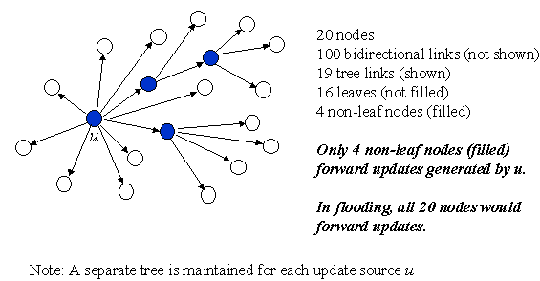
TBRPF(Topology Broadcast Based on Reverse Path Forwarding)
Full-topology link-state protocol (unlike OLSR)
Each link-state update is broadcast reliably along a dynamic min-hop-path tree rooted at the source of the update.

Slide 12
Reactive Routing Protocols
On demand routing protocol
Large, high mobility ad hoc network
Source build routes on-demand by “flooding”
Maintain only active routes
Typically, less control overhead, better scaling properties
Drawback: route acquisition latency
DSR, AODV, LMR, TORA, ABR

Slide 13
Dynamic Source Routing (DSR)
When node S wants to send a packet to node D, but does not know a route to D, node S initiates a route discovery
Source node S floods Route Request (RREQ)
Each node appends own identifier when forwarding RREQ
* some part of this teaching materials are prepared referencing the tutorial made by Prof. Nitin H. Vaidya University of Illinois at Urbana-Champaign

Slide 14

Route Discovery in DSR
Y
Broadcast transmission
[S]
Z
S
E
F
B
C
M
L
J
A
G
H
D
K
I
N
Represents transmission of RREQ
[X,Y] Represents list of identifiers appended to RREQ

Slide 15
Route Discovery in DSR
Y
Z
S
E
F
[S,E,F,J,M]
B
C
M
L
J
A
G
H
D
K
I
N
Node D does not forward RREQ, because node D
is the intended target of the route discovery

Slide 16
Route Discovery in DSR
Destination D on receiving the first RREQ, sends a Route Reply (RREP)
RREP is sent on a route obtained by reversing the route appended to received RREQ
RREP includes the route from S to D on which RREQ was received by node D

Slide 17
Route Reply in DSR
Y
Z
S
E
RREP [S,E,F,J,D]
F
B
C
M
L
J
A
G
H
D
K
I
N
Represents RREP control message

Slide 18
Dynamic Source Routing (DSR)
Node S on receiving RREP, caches the route included in the RREP
When node S sends a data packet to D, the entire route is included in the packet header
hence the name source routing
Intermediate nodes use the source route included in a packet to determine to whom a packet should be forwarded

Slide 19
Data Delivery in DSR
Y
DATA [S,E,F,J,D]
Z
S
E
F
B
C
M
L
J
A
G
H
D
K
I
N
Packet header size grows with route length

Slide 20
Ad Hoc On-Demand Distance Vector Routing (AODV) [Perkins99Wmcsa]
DSR includes source routes in packet headers
Resulting large headers can sometimes degrade performance
AODV attempts to improve on DSR by maintaining routing tables at the nodes, so that data packets do not have to contain routes
When a node re-broadcasts a Route Request, it sets up a reverse path pointing towards the source
AODV assumes symmetric (bi-directional) links
When the intended destination receives a Route Request, it replies by sending a Route Reply
Route Reply travels along the reverse path set-up when Route Request is forwarded

Slide 21
Route Reply in AODV
Y
Z
S
E
F
B
C
M
L
J
A
G
H
D
K
I
N
Represents links on path taken by RREP

Slide 22
Forward Path Setup in AODV
Routing table entries used to forward data packet.
Route is not included in packet header.
Y
Z
S
E
F
B
C
M
L
J
A
G
H
D
K
I
N
Forward links are setup when RREP travels along
the reverse path
Represents a link on the forward path

Slide 23
Flooding of Control Packets
How to reduce the scope of the route request flood ?
LAR [Ko98Mobicom]
Query localization [Castaneda99Mobicom]
How to reduce redundant broadcasts ?
The Broadcast Storm Problem [Ni99Mobicom]

Slide 24
Solutions for Broadcast Storm
Probabilistic scheme: On receiving a route request for the first time, a node will re-broadcast (forward) the request with probability p
Also, re-broadcasts by different nodes should be staggered by using a collision avoidance technique (wait a random delay when channel is idle)
this would reduce the probability that nodes B and C would forward a packet simultaneously in the previous example
Counter-Based Scheme: If node E hears more than k neighbors broadcasting a given route request, before it can itself forward it, then node E will not forward the request
Intuition: k neighbors together have probably already forwarded the request to all of E’s neighbors

Slide 25
Hierarchical Routing Protocols
1.CGSR (Clusterhead-Gateway Switch Routing)
2.HSR (Hierarchical State Routing)
3.ZRP (Zone Routing Protocol)
4.LANMAR (Landmark Ad Hoc Routing Protocol)

Slide 26
Hybrid Protocols
Zone Routing Protocol (ZRP) [Haas98] combines
Intra-zone routing: Pro-actively maintain state information for links within a short distance from any given node
Routes to nodes within short distance are thus maintained proactively (using, say, link state or distance vector protocol)
Inter-zone routing: Use a route discovery protocol for determining routes to far away nodes. Route discovery is similar to DSR with the exception that route requests are propagated via peripheral nodes. => Reactive

Slide 27
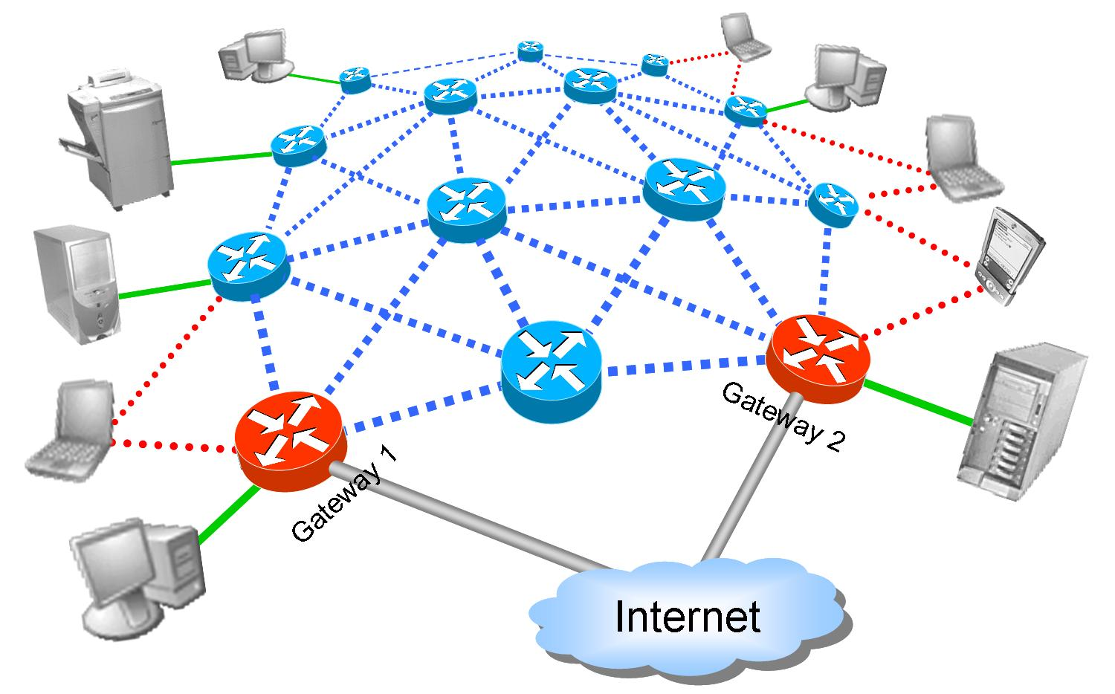
Wireless Mesh Network
Node Types
Link Types
Wireless routers
Gateways
Printers, servers
Mobile clients
Stationary clients
Intra-mesh wireless links
Stationary client access
Mobile client access
Internet access links
A special type of wireless ad-hoc network

Slide 28
Existing Routing Protocols
Internet routing protocols (e.g., OSPF, BGP, RIPv2)
Well known and trusted
Designed on the assumption of seldom link changes
Without significant modifications are unsuitable for WMNs in particular or for ad hoc networks in general.
Ad-hoc routing protocols (e.g., DSR, AODV, OLSR, TBRPF)
Newcomers by comparison with the Internet protocols
Designed for high rates of link changes; hence perform well on WMNs
May be further optimized to account for WMNs’ particularities
Ad Hoc
Networks
Wireless Mesh
Networks

Slide 29
VANET

Slide 30
VANET
Vehicular Ad hoc NETwork
Compared to MANET
Move at higher speeds (0-40 m/s)
No battery and storage constraints
Opportunistic connectivity
Like mobile sensor network
Opportunistic forwarding
DTN

Slide 31
VANET
Centralized V2I/I2V communications
Wi-MAX
Long Term Evolution (LTE)
Ad hoc V2V and centralized V2I/I2V communications
IEEE 802.11
IEEE 802.11p

Slide 32
VANET
Kevin C. Lee et al., “Survey of Routing Protocols in Vehicular Ad Hoc Networks” 2012

Slide 33
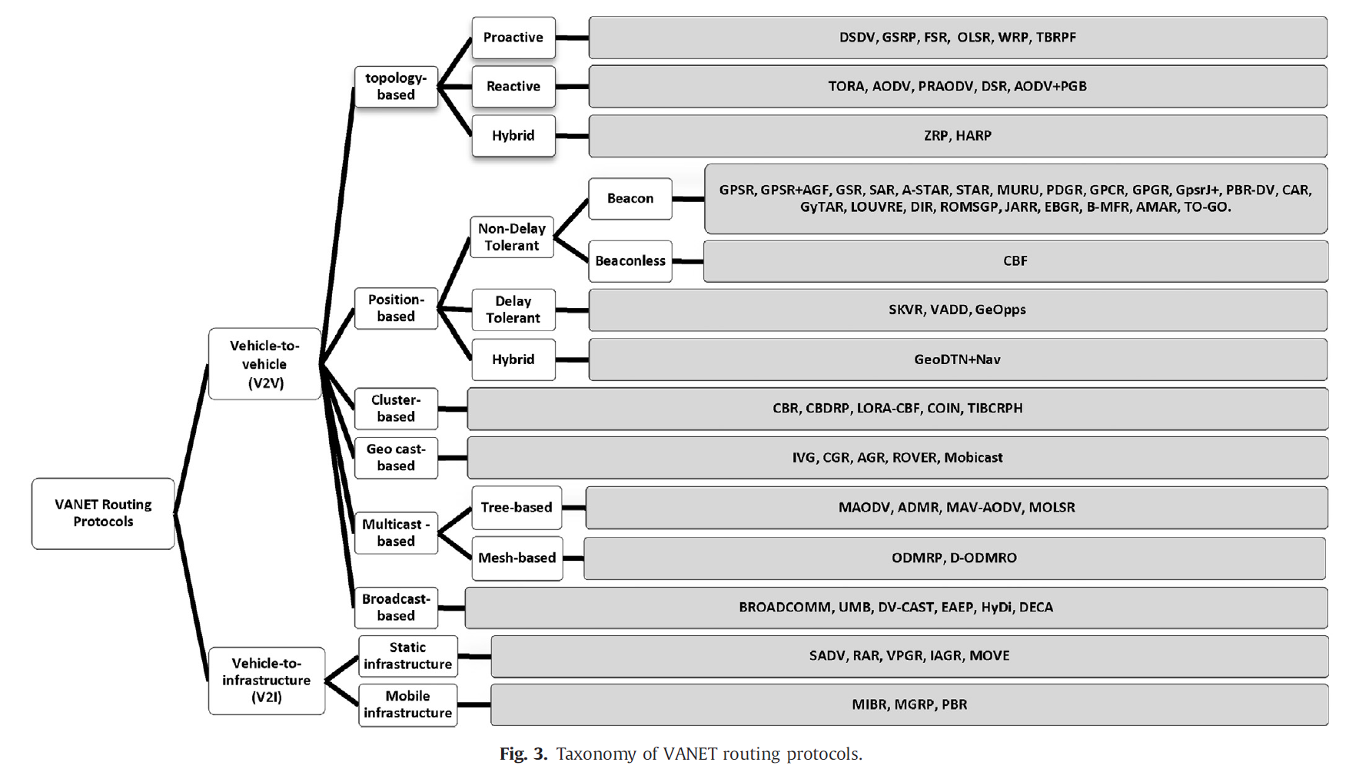
VANET
BaraaT.Sharef et al., “Vehicular communication ad hoc routing protocols: A survey” 2014

Slide 34
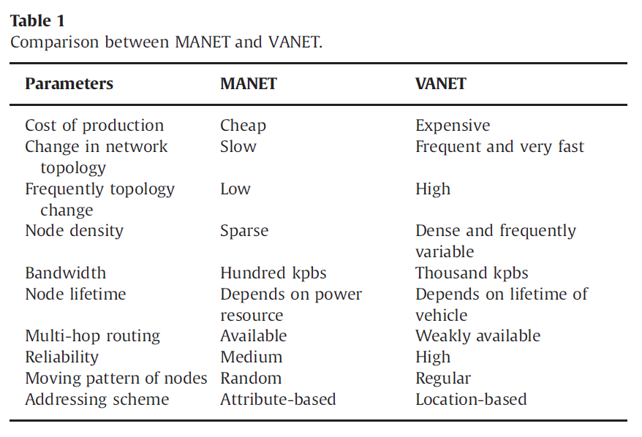
VANET vs. MANET
BaraaT.Sharef et al., “Vehicular communication ad hoc routing protocols: A survey” 2014

Slide 35
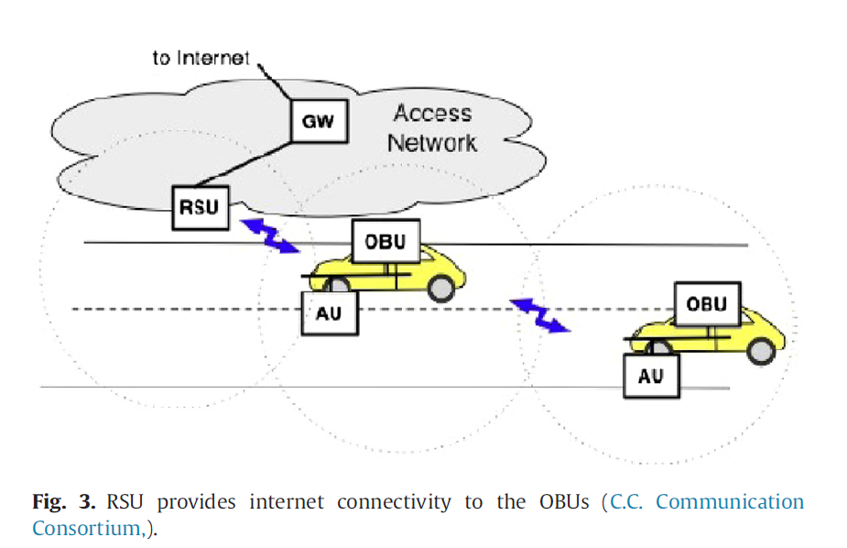
VANET

Slide 36
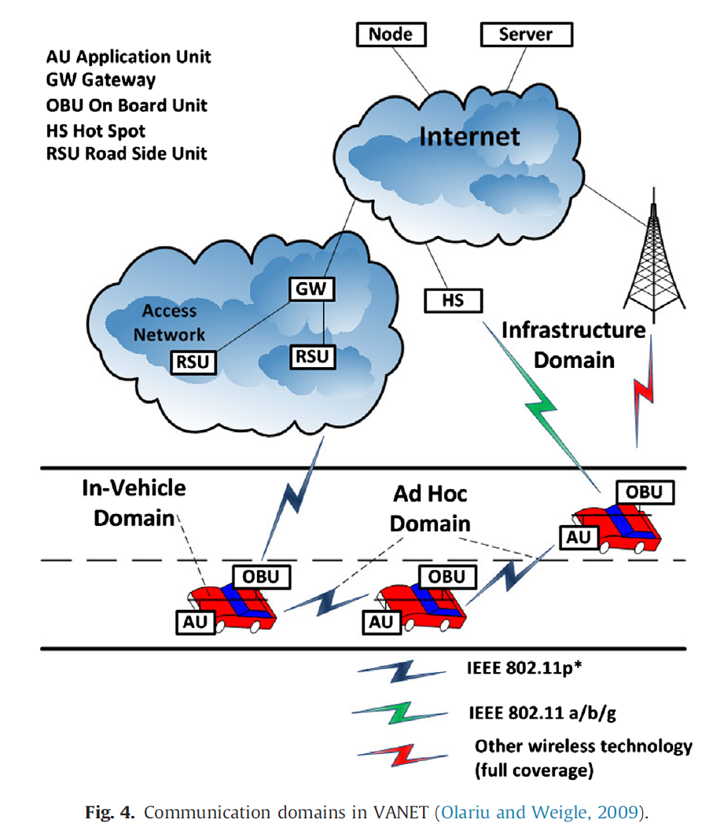
VANET

Slide 37
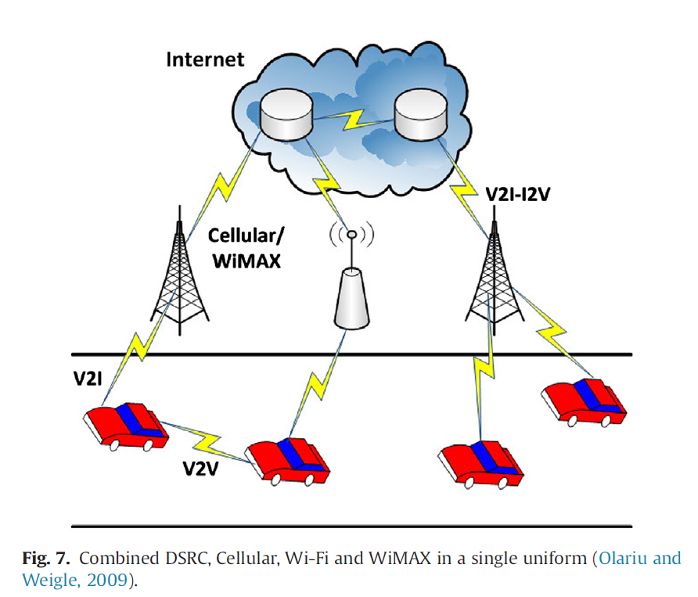
VANET

Slide 38
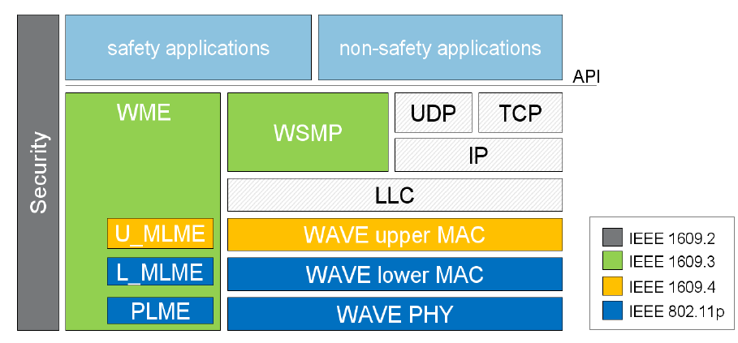
WAVE

